Slide 1

www.europeaneconomics.com

Slide 2
The public funding of Important Projects of Common European Interest (IPCEI)
Marc Isabelle
european economics
marc.isabelle@europeaneconomics.com
+33 673 116 109
Kick-off meeting – McPhy February 24th, 2020

Slide 3
Presentation outline
General principles of State aid regulation
The State aid notification procedure
An overview of IPCEIs
The eligibility criteria of an IPCEI
R&D / FID / Environmental, energy or transport projects (infrastructure)
Spill-overs in the IPCEI regulation
Feedback on spill-overs from previous IPCEI
Examples of spill-overs
Conclusions
© Marc Isabelle - european economics

Slide 4


General principles of State aid regulation
State aid = fourth pillar of European competition law
Internal market
Mergers
Cartels
Antitrust
State aid
© Marc Isabelle - european economics

Slide 5

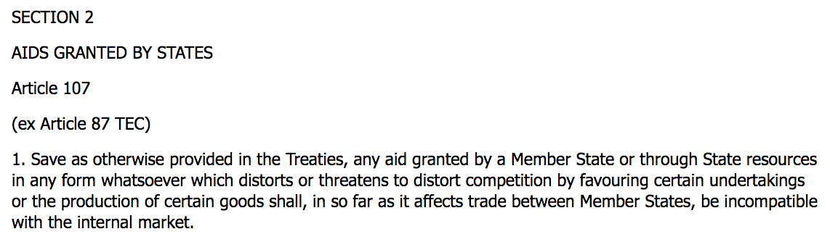
General principles of State aid regulation
State aid are forbidden
Art. 107-1 Treaty on the Functioning of the European Union (TFEU)
© Marc Isabelle - european economics

Slide 6

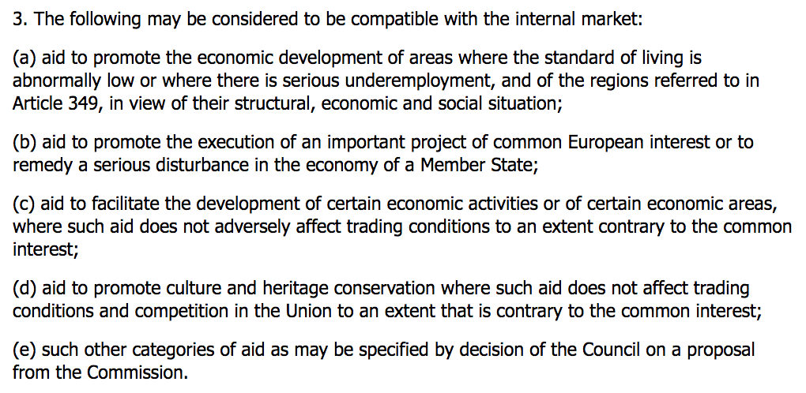
General principles of State aid regulation
… unless justified by reasons of general economic development
Art. 107-3 Treaty on the Functioning of the European Union (TFEU)
© Marc Isabelle - european economics

Slide 7
General principles of State aid regulation
What is the reason for this regulation (since 1957)?
Idea that a market-based economy provides the best guarantee for raising living conditions in the EU to the benefit of citizens (lower prices, more variety and better quality, more innovation, …)
Need to maintain a level playing field for all undertakings active in the Single European Market
A company which receives government support usually gains an advantage over its competitors, which then have an interest to take action by opposing State aid law
State aid complaint form
© Marc Isabelle - european economics

Slide 8
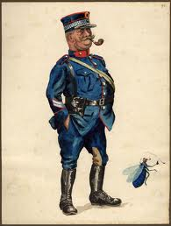

General principles of State aid regulation
The role of the European Commission
EC is in charge of ensuring that State aid complies with EU rules:
control
investigation
recovery of illegal or incompatible aid
definition of soft law
decisional practice
The police(wo)man
DG Competition is responsible for competition matters
http://ec.europa.eu/competition/index_en.html
© Marc Isabelle - european economics

Slide 9
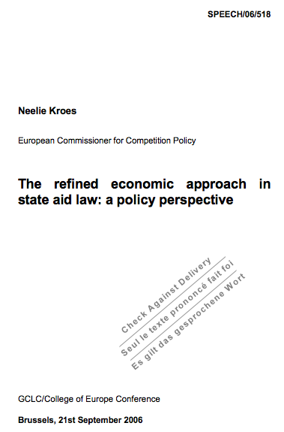
General principles of State aid regulation
More economics in State aid control since 2007
DG Competition commissioner Neelie Kroes State Aid Action Plan (2005-2006)
http://europa.eu/rapid/press-release_SPEECH-06-518_en.pdf
© Marc Isabelle - european economics

Slide 10
General principles of State aid regulation
What is (not) State aid?
State aid = public resources that favour a specific business:
Subsidies
Repayable advances
Soft loans Market money
Equity
Guarantee
>
… and that might give an advantage to a given enterprise at the expense of its competitors on the internal market
NB : Enterprise = « any entity engaged in an economic activity, irrespective of its legal form »
© Marc Isabelle - european economics

Slide 11
General principles of State aid regulation
State aid or not State aid: combining various public funding sources
The decisive element in the classification of resources as State resources is not their origin but whether the State can exercise control over them
Allocation decision
 | European Union | Member State / Public agency | Local government
European Union | Horizon Europe |  | ERDF
Member State / Public agency |  | IPCEI
Local government |  |  | Local support
Funding source
Where Union funding is combined with State aid, only the latter will be considered for determining notification thresholds and aid intensities
© Marc Isabelle - european economics

Slide 12
General principles of State aid regulation
European Commission’s control ex ante: a strong threshold effect
Art. 108-3 TFEU The Commission shall be informed, in sufficient time to enable it to submit its comments, of any plans to grant or alter aid
Individual notification
Detailed analysis
EC’s control ex ante
GBER
Simple information
State aid amount
(per beneficiary per project)
7,5
e.g. R&D 15 M€
20 depending on the project’s distance from the market
Art. 4 p.31 GBER (General Block Exemption Regulation)
© Marc Isabelle - european economics

Slide 13
General principles of State aid regulation
GBER: a large safe harbour (since 2014)
State aid for research and development and innovation
(Ref. 2014/C 198/01 of 27 June 2014)
State aid for environmental protection and energy 2014-2020
(Ref. 2014/C 200/01 of 28 June 2014)
General Block Exemption Regulation
(Ref. N° 651/2014 of 17 June 2014)
Regional aid
(Ref. 2013/C 209/01 of 23 July 2013)
State aid to promote risk finance investments
(Ref. 2014/C 19/04 of 22 January 2014)
Training aid
(Ref. 2009/C 188/01 of 11 August 2009)
State aid to promote the execution of important projects of common European interest
(Ref. 2014/C 188/02 of 20 June 2014)
Out of GBER
State aid for rescuing and restructuring non-financial undertakings in difficulty
(Ref. 2014/C 249/01 of 31 July 2014)
© Marc Isabelle - european economics

Slide 14
The State aid notification procedure
European Commission’s control ex ante: no threshold effect for IPCEIs
Individual notification
Detailed assessment
EC’s control ex ante
No GBER exemption
State aid amount
(per beneficiary per project)
> 0 M€
The individual notification process is part of the overall IPCEI life-cycle
© Marc Isabelle - european economics

Slide 15
The State aid notification procedure
The balancing test for compatibility assessment
The Commission considers a State aid measure to be compatible if and only if its positive economic effects overweight its negative economic effects
Balancing test
Positive effects
objective of common interest
market failure
incentive effect
appropriateness
necessity & proportionality
Negative effects
distorting dynamic in- -centives
creating market po- -wer
maintaining inefficient market structures
location effects
Tools derived from economic theory to assess whether the aid is likely to create wealth for the European Union
© Marc Isabelle - european economics

Slide 16
The State aid notification procedure
A very important milestone
Art. 108-3 TFEU The Member State shall not put its proposed measures into effect until this procedure has resulted in a final decision
Art. 108-2 TFEU If the Commission finds that aid is not compatible with the internal market, it shall decide that the Member State shall abolish such aid
Member States will not be allowed to pay a single euro of aid before the decision of the European Commission => timing of procedure is critical
© Marc Isabelle - european economics

Slide 17
The State aid notification procedure
A relatively short and pressurised process
1st EC questions reception
2nd EC questions reception
Additional EC questions
Pre-notification file sent
1st answers sent
2nd answers sent
Notification file sent
Start of work
EC decision
Materials
preparation
(PP + FGQ)
1st
evaluation
DG Comp
1st answers
preparation
Meeting
Brussels
Final
answers preparation
Drafting /
circulating
EC decision
T₀
T₄= T₀+ ≈ 3,5
months
T₄= T₀+ ≈ 4
months
T₄= T₀+ ≈ 4,5
months
T₆= T₀+ ≈ 7 months
T₁= T₀+ 2 moths
T₂= T₀+ 2,5 months
T₃= T₀+ ≈ 3 months
T₅= T₀+ ≈ 5 months
IPCEI process moves on under strong political pressure
Outcome = maximum State aid authorisation (no actual support)
© Marc Isabelle - european economics

Slide 18
The State aid notification procedure
A clear organisation
DG Competition
Member State
Beneficiary
… needs comprehensive information about:
… has the information about:
Project
Company
Market
NB: a company receiving public funding in several Member States can go through a single notification procedure; Member States must coordinate closely
© Marc Isabelle - european economics

Slide 19
The State aid notification procedure
A lot of drafting & brain juice
Notification file 80 pages “Project portfolio”
Business plans 15 versions “Funding Gap Questionnaire”
EC 1st set of questions 45 questions 45 additional pages
Business plans 8 versions
EC 2nd set of questions 30 questions 30 additional pages
Business plans 4 versions
EC additional questions 25 questions 25 additional pages
Business plans 3 versions
© Marc Isabelle - european economics

Slide 20
The State aid notification procedure
Anticipation is key
The notification procedure should be prepared as soon as possible & connected to the investment decision
E.g. proofs required by EC regarding necessity & proportionality of State aid =
Record of decision by Executive committee stating that a minimum of (say) € 100 millions is required to decide upon the investment
Business plan supporting the above decision
Materials should be prepared before the aid application
© Marc Isabelle - european economics

Slide 21
An overview of IPCEIs
Three preceding IPCEI experiences
Fehmarn Belt Fixed Linkproject (2015)
A 19 km immersed tunnel between Denmark and Germany – Notification for reasons of legal certainty following complaints from ferry operators alleging that Danish State had granted unlawful State aid – € 8.7 Bil. investment – € 2.8 Bil. State aid (guarantee, loan and capital)
IPCEI on Microelectronics (2018)
A project comprising R&D and First Industrial Deployment activities – 29 direct participants in France, Germany, Italy and the United Kingdom – € 7.75 Bil. budget – € 1.75 Bil. State aid (mainly direct grants)
Summer IPCEI on Batteries (2019)
A project comprising R&D and First Industrial Deployment activities – 18 direct participants in Belgium, Finland, France, Germany, Italy, Poland and Sweden – € 8.2 Bil. budget – € 3.2 Bil. State aid (mainly direct grants + claw-back mechanism)
© Marc Isabelle - european economics

Slide 22
An overview of IPCEIs
What is an IPCEI?
An Important Project of Common European Interest is a very-large scale integrated project
It must involve companies from several Member States
It must contribute in a concrete, clear and identifiable way to one or more objectives of the European Union
It must have a significant impact on competitiveness and sustainable growth
The IPCEI provides a unique opportunity to fund with public money:
Capex & Opex for R&D activities / First Industrial Deployment
construction of infrastructure in Environmental, Energy and Transport projects
Very important size (order of magnitude = € billions)
Long term (~ 5 years +)
Extensive partnership to structure strategic value chains in Europe
© Marc Isabelle - european economics

Slide 23
An overview of IPCEIs
A new funding tool for a reinforced European industrial policy
IPCEI = unique European regulatory framework for the funding of industrial activities by EU Member States (European Commission's communication on IPCEI)
The European Commission is involved in the design, selection, management structure and funding of IPCEIs (DG Grow, DG Move, DG Ener, DG RTD, JRC, DG Comp)
IPCEI = a financing tool that is foreseen to become more important in the near future for economic sectors open to strong global competition and contributing to the strategic independence of the European Union
The Strategic Forum for IPCEIs identified eight strategic value chains as best candidates for IPCEIs: Microelectronics (2018), Electric batteries (2019), Clean, Connected and Autonomous Vehicles, Smart Health, Low CO₂ emissions indus- -try, H₂ technologies and systems, Industrial Internet of Things, Cybersecurity
© Marc Isabelle - european economics

Slide 24
An overview of IPCEIs
An IPCEI has three interdependent layers
STRATEGIC VALUE CHAIN
Link #1
Link #2
Link #3
Link #4
Link #5
Strategic forum
…
Chapeau texts
Project #1
Project #2
…
…
Project portfolios
Funding Gap Questionnaires
Individual component #1a
Individual component #1b
Individual component #1c
Individual component #1z
Individual component #2a
Individual component #2b
Individual component #2c
Individual component #2x
© Marc Isabelle - european economics

Slide 25
An overview of IPCEIs
A way through the thicket from the idea to the start of activities
Step 1
Step 2
Step 3
Step 4
Step 5
Step 6
Original idea
Project draft
Insert IPCEI genes
Look for funding
Notification
Finish line
/
Start line
European Commission
Member State
Region / City
© Marc Isabelle - european economics

Slide 26
An overview of IPCEIs
The role of public authorities
Preparation
Application
Notification
Talk with:
European Commission
Other Member States
Local authorities
Candidates
Talk with:
European Commission
Other Member States
Local authorities
Candidates
Issue calls
Assess applications
Select participants
Decide funding
National governments have a key role: supporting, coordinating and notifying the IPCEI
© Marc Isabelle - european economics

Slide 27
An overview of IPCEIs
Financial engineering: eligible & non eligible costs, State aid intensity
Non-eligible costs
Own funding
State aid intensity
up to 100 % of eligible costs
Eligible costs
State aid
© Marc Isabelle - european economics

Slide 28
An overview of IPCEIs
Categories of eligible costs
The company may receive State aid for the following expenses
R&D / Energy Transport Environment projects
Feasibility studies
Costs of instruments & equipment (depreciation within the project lifetime)
Costs of acquisition / construction of buildings (depreciation within the project lifetime)
Costs of patents / intangible assets / contractual research
Costs of materials / supplies
Personnel / administrative costs including overheads (only for construction not exploitation)
First Industrial Deployment
Capital expenditures (excluding the share allocated to mass production => transition point from FID to mass production should be looked at carefully)
Operational expenditures which relate to the RDI component (incl. personnel & administrative costs, overheads )
© Marc Isabelle - european economics

Slide 29
The eligibility criteria of an IPCEI
Sources of soft law
An IPCEI is any type of project that ticks all the IPCEI eligibility boxes set in “Part 3. Eligibility criteria” of the following document:
“Criteria for the analysis of the compatibility with the internal market of State aid to promote the execution of important projects of common European interest Ref. 2014/C 188/02” The IPCEI communication
This IPCEI communication has been complemented in 2018 (during the notification of the IPCEI on Microelectronics) by several Commission’s IPCEI non papers:
on antitrust
on integration
on proportionality
on RDI content
on spillover effects
© Marc Isabelle - european economics

Slide 30
The eligibility criteria of an IPCEI
What are the eligibility criteria?
List of criteria which the Commission will use to assess the nature and the importance of such projects for the purposes of the application of Article 107(3)(b) of the Treaty
Eligibility criteria:
3.1. Definition of a project
3.2. Common European interest
3.2.1. General cumulative criteria
3.2.2. General positive indicators
3.2.3. Specific criteria
3.3. Importance of the project
Only two pages in the IPCEI Communication
© Marc Isabelle - european economics

Slide 31
The eligibility criteria of an IPCEI
How much interconnected should the activities be?
Either one project (e.g. Fehmarn Belt Fixed Linkproject)
… or a group of projects inserted in a common structure, roadmap or programme (e.g. IPCEI on Microelectronics & IPCEI on Batteries)
where individual components must be complementary and necessary for the achievement of the European objectives
The demonstration of the integration of individual projects in the IPCEI is performed through the preparation of a “Chapeau text” (after the selection of participants at national levels) where all companies and Member States bring their contribution; this document is shared among participants and is non-confidential
NB: the “project” refers to the IPCEI globally speaking, not to the individual components
© Marc Isabelle - european economics

Slide 32
The eligibility criteria of an IPCEI
How to tick the “Common European interest” box?
The project must contribute in a concrete, clear and identifiable manner to one or more Union objectives and must have a significant impact on competitiveness of the Union, sustainable growth, addressing soci­etal challenges or value creation across the Union
Not a big issues for Hydrogen & Fuel cells which are contributing (i) to EU strategy for competitive, sustainable and secure energy, (ii) to EU policy framework for climate and energy, (iii) to the European Energy Security Strategy, etc.
The project (the IPCEI) must involve more than one Member State
But to tick the ”Common European interest” box, the benefits of the project must also not be limited to the undertakings or to the sector concerned but must be of wider relevance and application to the European economy or society through positive spillover effects which are clearly defined in a concrete and identifiable manner
© Marc Isabelle - european economics

Slide 33
The eligibility criteria of an IPCEI
The European Commission should be stakeholder
The European Commission, along with Member States, should be involved in:
The design of the project
The selection of the project
The governance structure of the project
The funding of the project
The IPCEI on Hydrogen could be larger than the previous ones by an order of magnitude; it will be necessary to use every possible funding sources (national, regional, local, European Union, banks incl. EIB and equity…)
© Marc Isabelle - european economics

Slide 34
The eligibility criteria of an IPCEI
The project must be large, composite and very risky
Large means several € billions (based on previous experiences)
Composite means:
collaborative interactions in terms of number of partners (tens according to previous experiences)
involvement of organisations of different sectors (all along the strategic value chain according to previous experiences)
the involvement of undertakings of different sizes (the Commission highly values the participation of SMEs along with LEs)
Very risky means:
a very considerable level of technological risk (e.g. not business as usual R&D and innovation)
a very considerable level of financial risk (e.g. large investments and uncertain markets, long pay-backs)
© Marc Isabelle - european economics

Slide 35
R&D / FID / Energy Transport Environment
Three IPCEIs so far, two families
Costs
Mass production / commercialisation
Eligible costs
IPCEI Microelectronics / IPCEI Batteries
FID
Non eligible costs
R&D
T₀
T_{end}
Time
Costs
Fehmarn Belt Fixed Linkproject
Eligible costs
Operation
Planning & Construction
Non eligible costs
T₀
T_{end}
Time
© Marc Isabelle - european economics

Slide 36
R&D / FID / Energy Transport Environment
The specific eligibility criteria of an IPCEI
Any company could cherry-pick one, two or three of the following activities to contribute to an IPCEI:
“R&D&I projects must be of a major innovative nature or constitute an important added value in terms of R&D&I in the light of the state of the art in the sector concerned” (point 21. IPCEI Communication)
“Projects comprising of industrial deployment must allow for the development of a new product or service with high research and innovation content and/or the deployment of a fundamentally innovative produc­tion process. Regular upgrades without an innovative dimension of existing facilities and the development of newer versions of existing products do not qualify as IPCEI” (point 22. IPCEI Communication)
“Environmental, energy or transport projects must either be of great importance for the environmental, energy, including security of energy supply, or transport strategy of the Union or contribute significantly to the internal market, including, but not limited to those specific sectors” (point 23. IPCEI Communication)
© Marc Isabelle - european economics

Slide 37
R&D / FID / Energy Transport Environment
How to make R&D&I activities eligible?
Describe the state of the art in the sector concerned, in detailed scientific & technical terms + with KPIs (section 1.4.1 of the Project Portfolio)
Describe the technical locks which prevent further improvements in the sector (section 1.4.2 of the Project Portfolio)
Describe the objectives of the R&D&I activities (incl. KPIs) and explain in detailed technical terms how the company plans to reach the targets (section 1.4.3 of the Project Portfolio)
20 pages recommended (1/4th of the Project portfolio); more than half of the Commission’s questions point at section 1.4 on innovativeness
© Marc Isabelle - european economics

Slide 38
R&D / FID / Energy Transport Environment
How to make FID activities eligible?
First industrial deployment refers to the upscaling of pilot facilities, or to the first-in-kind equipment and facilities which cover the steps subsequent to the pilot line including the testing phase => make your choice and describe the purpose of the FID activities (section 1.5.1 of the Project Portfolio)
Describe the technical challenges in the FID phase and explain how the company plans to overcome them (section 1.5.2 of the Project Portfolio)
FID does not include mass production nor commercial activities; the costs of these activities are not eligible to public funding => describe the KPIs and the associated values that will trigger the transition from FID (a facility which smokes and sparks and has a lot of scrap) to mass production / commerciali- -sation (a fully-efficient industrial facility) (section 1.5.3 of the Project Portfolio)
10 pages recommended (1/8th of the Project portfolio); more than a quarter of the Commission’s questions point at section 1.5 on FID
© Marc Isabelle - european economics

Slide 39
R&D / FID / Energy Transport Environment
How to make environmental, energy or transport projects eligible?
Hydrogen & Fuel cells, as innovative technologies for energy storage and production, contributes to a better integration of intermittent electricity sources (wind, solar)
Hydrogen & Fuel cells, as a innovative technologies for the transportation of energy from areas of production to areas of consumption, contributes to a better integration of the European energy market
Hydrogen & Fuel cells, as innovative powering technologies for heavy duty vehicles, commercial vehicles, boats, trains, … contributes to cleaner transportation means
Regarding personnel and administrative costs specifically, only those that are incurred during the construction of the infrastructure are eligible to public funding
© Marc Isabelle - european economics

Slide 40
R&D / FID / Energy Transport Environment
How to make environmental, energy or transport projects eligible?
Hydrogen & Fuel cells, as innovative technologies for energy storage and production, contributes to a better integration of intermittent electricity sources (wind, solar)
Hydrogen & Fuel cells, as a innovative technologies for the transportation of energy from areas of production to areas of consumption, contributes to a better integration of the European energy market
Hydrogen & Fuel cells, as innovative powering technologies for heavy duty vehicles, commercial vehicles, boats, trains, … contributes to cleaner transportation means
Regarding personnel and administrative costs specifically, only those that are incurred during the construction of the infrastructure are eligible to public funding
© Marc Isabelle - european economics

Slide 41
The spillovers of an IPCEI
The results of an IPCEI shall benefit the European society at large
“The benefits of the project must not be limited to the undertakings or to the sector concerned but must be of wider relevance and application to the European economy or society through positive spillover effects (such as having systemic effects on multiple levels of the value chain, or up- or downstream markets, or having alternative uses in other sectors or modal shift) which are clearly defined in a concrete and identifiable manner” (point 17. IPCEI Communication)
Companies receiving State aid for an IPCEI must commit to disseminate the results they will obtain in the project; commitments shall be proportionate to the risk posed on competition by the company’s public funding
NB: Spillover commitments also provide some form of protection against law suits attempted by third parties that do not participate in the IPCEI
© Marc Isabelle - european economics

Slide 42
The spillovers of an IPCEI
Three main categories of spillovers
Spillover by diffusion of non-IP protected results (section 3.1 of the Project Portfolio)
Conferences and scientific publications
Workshops & events
PhDs and post-doc fellows
Education
Participation in European collaborative research programs
Press releases and media activities
Spillover by diffusion of IP protected results (section 3.2 of the Project Portfolio)
Commitments to grant IP licenses on FRAND conditions
Spillover in the FID phase (section 3.3 of the Project Portfolio)
Open access to pilot and FID lines to research organisations and SMEs
Spillovers must be clearly defined in a concrete and identifiable manner
© Marc Isabelle - european economics

Slide 43
Necessity & Proportionality of IPCEI State aid
The State aid must be necessary to decide upon the investment
“The aid must not subsidise the costs of a project that an undertaking would anyhow incur and must not compensate for the normal business risk of an economic activity. Without the aid the project’s realisation should be impossible, or it should be realised in a smaller size or scope or in a different manner that would significantly restrict its expected benefits” (point 28. IPCEI Communication)
If the company carries out the project anyhow, you’d better keep the public money for another purpose
Analysis of the necessity based on a nominal business plan = the Internal Rate of Return without State aid must be below the hurdle rate (or the NPV must be negative = Funding Gap)
© Marc Isabelle - european economics

Slide 44
Necessity & Proportionality of IPCEI State aid
The State aid must be proportionate i.e. limited to the minimum amount
“[…] the Commission will verify that the aid amount does not exceed the minimum necessary for the aided project to be sufficiently profitable, for example by making possible to achieve an IRR corresponding to the sector or firm specific benchmark or hurdle rate. Normal rates of return required by the beneficiary in other investment projects of a similar kind, its cost of capital as a whole or returns commonly observed in the industry concerned may also be used” (point 30. IPCEI Communication)
The public support shall not generate windfall profits
Analysis of the proportionality based on a nominal business plan = the Internal Rate of Return with State aid must be equal to the hurdle rate
© Marc Isabelle - european economics

Slide 45
Necessity & Proportionality of IPCEI State aid
The Funding Gap Questionnaire
The Funding Gap Questionnaire is a standard business plan of the project built so as to make the identification of eligible costs possible:
one section for R&D eligible costs
one section for FID eligible costs
one section for infrastructure eligible costs
one section for mass produc° / commercialis° / exploit° non eligible costs
The duration shall be chosen so as to capture all the value of the investment
The maximum State aid requirement can be calculated as a fixed proportion of eligible costs every year (aid intensity) so as to achieve the targeted IRR
© Marc Isabelle - european economics

Slide 46
Necessity & Proportionality of IPCEI State aid
The claw-back mechanism
In order to guarantee the proportionality of State aid during the project’s operation, a claw-back mechanism can be put in place by which the company shall repay “extra” profits to the Member State during the project’s operation
First experience with the IPCEI on Batteries:
Every five years, the Funding Gap is compared to the actual State aid disbursements; a share of the surplus, if any, is clawed-back to the Member State
No feedback on the claw-back mechanism so far
© Marc Isabelle - european economics

Slide 47
IPCEI on Hydrogen
Conclusions
IPCEI Microelectronics & IPCEI Batteries 1st and 2nd of-a-kind => strong learning process; highly valuable information and knowledge can be derived from preceding experiences
Go cherry-picking the type of activities you would like to promote in the IPCEI
Look for complementary public funding sources
Very strong pressure on timing (“hurry up” = dominant project management tool)
Notification procedure should be anticipated as soon as possible (e.g. gathering of proofs)
Constraint on State aid amount could arise from a narrow definition of eligible costs, not so much from the Funding Gap analysis
Commitments to spillovers could be the focus of a specific WP on dissemination activities
© Marc Isabelle - european economics

Slide 48
Thank you for your attention!
© Marc Isabelle - european economics

